Slide 1
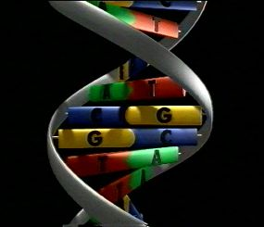
Molecular Genetics
The Molecular Basis of Inheritance

Slide 2
I. DNA: Deoxyribose Nucleic Acid
a) Overview:
1. DNA is the most important regulator of life processes in prokaryotes and eukaryotes.
2. DNA molecules manifest their importance by serving as the instructions which allow the cell to construct proteins, including enzymes, which serve as catalysts for all the functions of living systems.

Slide 3
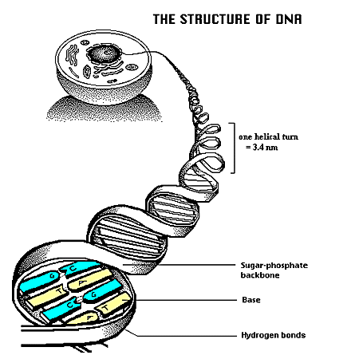

Slide 4
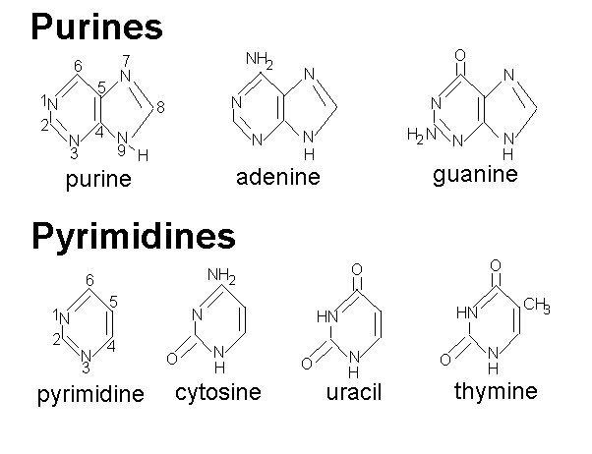
b) Structure of DNA
1. DNA consists of two helical backbones comprised of nucleotides.
2. Each nucleotide is constructed of a pentose sugar (deoxyribose), a phosphate (which is attached to the 5' carbon) and a nitrogenous base.
3. The nitrogenous bases, adenine and guanine are purines; thymine and cytosine are pyrimidines.

Slide 5
4. Nitrogenous bases on the two strands are linked to one another by hydrogen bonding between a purine and a pyrimidine according to the rule of complementary base pairing, (adenine only associates with thymine, guanine only associates with cytosine).
5. It’s shape is characterized as a double helix or twisted ladder in shape.
6. The 3-D shape was characterized by Watson and Crick 1953.
7. Genes and chromosomes consists of DNA.

Slide 6
8. A gene may be thought of as part of a strand of DNA which provides all of the information necessary for a cell to make a specific protein molecule.
9. Due to its length, a DNA molecule may contain thousands of genes.
NOTE:
In eukaryotes, DNA molecules along with histones comprise chromosomes which reside within the nucleus.
DNA molecules are also found within chloroplasts and mitochondria.
In a prokaryote cell, the single chromosome exists as a circular molecule of DNA found in a region called the nucleoid.
Some bacteria also have plasmids, which are circular molecules of DNA composed of up to about 100 genes.
A variety of differences exist between chromosomes of prokaryotes and eukaryotes.

Slide 7
c) Historical Background
How did we come to know the principles concerning the structure and significance of DNA?
1. Griffith and Avery, et al. (1920-1944) conducted experiments on the phenomenon of bacterial transformation.
When heat-killed virulent Pneumococcus cells were mixed with living nonvirulent cells and injected into mice, the mice died.
Neither heat-killed virulent cells nor living non-virulent cells alone killed mice.
Hence, the workers concluded that DNA (rather than protein, which would have been destroyed by the heat treatment) of the heat-killed cells transformed non-virulent cells into virulent ones.

Slide 8
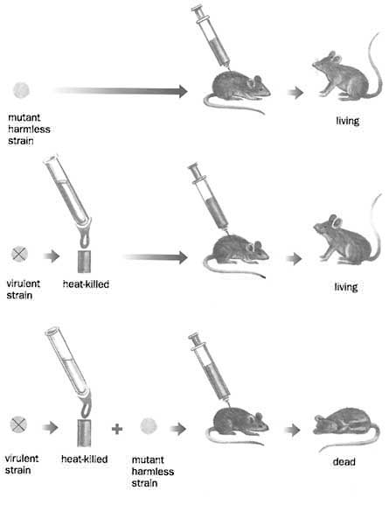
Griffith Experiment

Slide 9
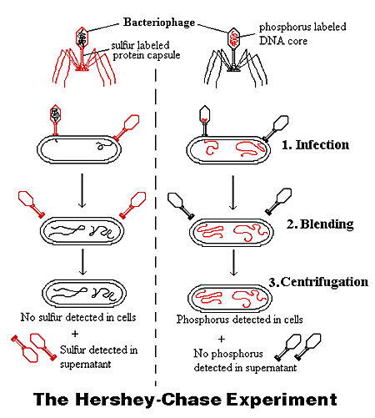
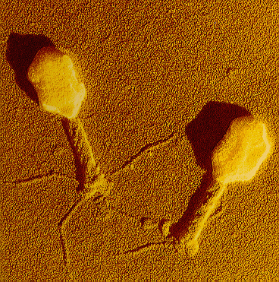
2. Hershey and Chase (1952) attempted to determine if protein or DNA contains the genetic material.
Bacteriophages (viruses) were grown on hosts containing either radioactive sulfur (which labeled the protein coat) or radioactive phosphorus (which labeled the DNA).
The workers showed that the radioactive phosphorus in the DNA was transferred from one virus generation to the other; radioactive sulfur was not.

Slide 10
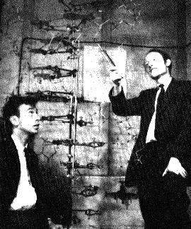
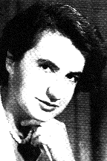
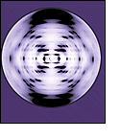
3. Chargaff (1949) demonstrated that regardless of species, the base content ratios show that A=T and G=C (rule of base pairing).
Subsequently, this information proved valuable in helping to determine the structure of DNA.
4. Rosalind Franklin (1952) used an X-ray diffractometer to show that DNA is a helical molecule with 10 bases per turn.
5. Watson and Crick, along with Wilkins proposed the structure of DNA in the 1950s and got the Nobel Prize in 1962.
Rosalind Franklin
DNA
X-Ray Diffraction Pattern
Watson and Crick

Slide 11
6. Meselson and Stahl demonstrated that DNA molecules are copied via a process called semiconservative replication.
They used "heavy nitrogen" for this work and were able to document that when a molecule of DNA replicates, the backbones separate and each serves as a template for production of a new strand, thus insuring exact copying.
7. Sanger and Gilbert (in the 1970s) determined how nucleotide sequencing could be accomplished using restriction enzymes.
This discovery revolutionized molecular biology and allowed for development of various techniques in "genetic engineering" research.

Slide 12
II. DNA Replication
a) Watson and Crick were particularly excited about their model because the complementary nature of the DNA molecule suggested a way in which it might self-replicate.
b) The two strands could separate from one another, each still containing the complete information, and synthesize a new strand.
c) However, experiments still had to be done to prove that this model was true.

Slide 13
d) Messelson and Stahl
1. In 1957, Matthew Meselson and Franklin Stahl did an experiment to determine which of the following models best represented DNA replication:
“Did the two strands unwind and each act as a template for new strands?”. This is semiconservative replication, because each new strand is half comprised of molecules from the old strand.
“Did the strands not unwind, but somehow generate a new double stranded DNA copy of entirely new molecules?”. This is conservative replication

Slide 14
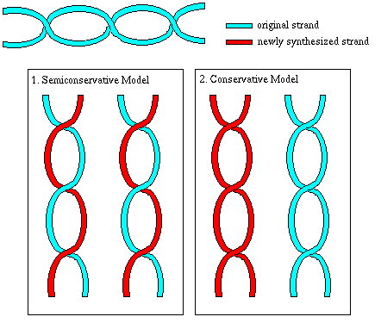
Semiconservative versus Conservative Replication

Slide 15
2. To determine which of these models was true, the following experiment was performed:
The original DNA strand was labelled with the heavy isotope of nitrogen, N-15.
This DNA was allowed to go through one round of replication with N-14, and then the mixture was centrifuged so that the heavier DNA would form a band lower in the tube, and the intermediate (one N-15 strand and one N-14 strand) and light DNA (all N-14) would appear as a band higher in the tube.
The expected results for each model were:

Slide 16
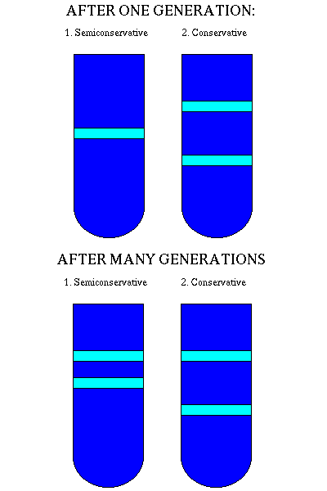
Messelson and Stahl Experiment

Slide 17
III. Biochemical Mechanism of DNA Replication
NOTE: It is very important to know that DNA replication is not a passive and spontaneous process.
Many enzymes are required to unwind the double helix and to synthesize a new strand of DNA.
a) Overview of DNA Replication
1. DNA Replication occurs prior to mitosis and meiosis.
2. Each individual DNA strand serves as a template for replication.
3. The replication process occurs in one direction only.

Slide 18
b) Sequence of Events in DNA Replication
1. Initiation: specialized sites known as origins of replication represent location on the DNA molecule where it separates to form “bubbles”. A specialized sequence of nucleic acids (RNA) that initiate replication is called a primer which is fixed to the template strand by the enzyme known as primase.
Topoisomerase is responsible for initiation of the unwinding of the DNA.
Helicase accomplishes unwinding of the original double strand, once supercoiling has been eliminated by the topoisomerase.
NOTE: Eukaryotes may have thousands of origin sites while prokaryotes only have one site of origin.
Single stranded binding proteins stabilizes the unzipped DNA molecule.
Nucleotide triphosphates are used as building blocks for new DNA.
The hydrolysis of triphosphates to monophosphates provides energy for polymerization; the enzyme DNA polymerase catalyzes polymerization.

Slide 19
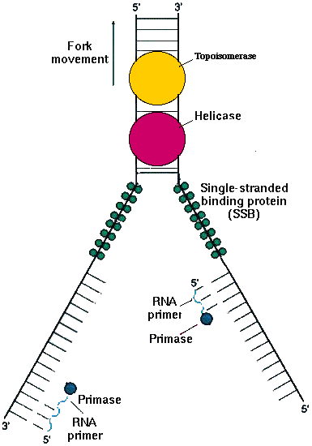
INITIATION

Slide 20
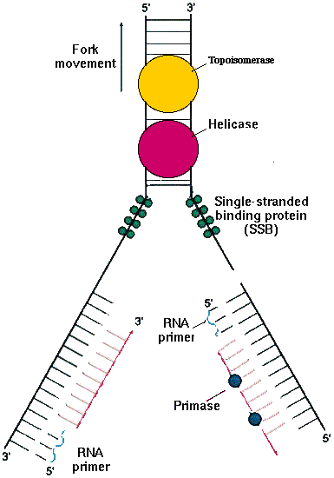
REPLICATION

Slide 21
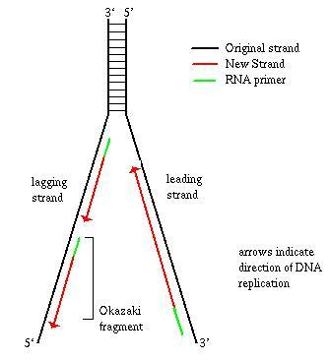
2. Replication forks are produced when parental DNA strands separate for replication. The synthesis of new replication forks along the DNA strands is known as initiation.
Replication Fork: DNA
Note the antiparallel nature of the DNA molecule.
The leading strand is aligned in a 3’ to 5’ orientation while the lagging strand aligned in a 5’ to 3’ orientation.

Slide 22
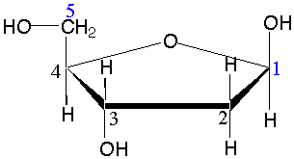
Deoxyribose

Slide 23
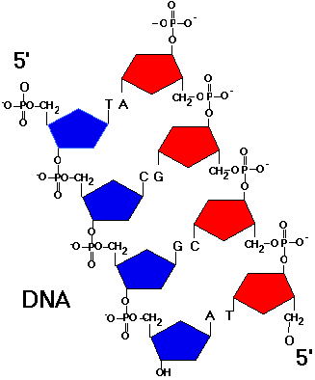
The Antiparallel Nature of the DNA Molecule

Slide 24
3. DNA polymerases, enzymes that catalyze replication, elongate the newly synthesized DNA strands at a replication fork.
4. DNA polymerases adds nucleotides to the template strands only in the 5’ to 3’ direction with respect to the elongating DNA strand.
5. The leading strand is the DNA template in which replication is continuous.

Slide 25
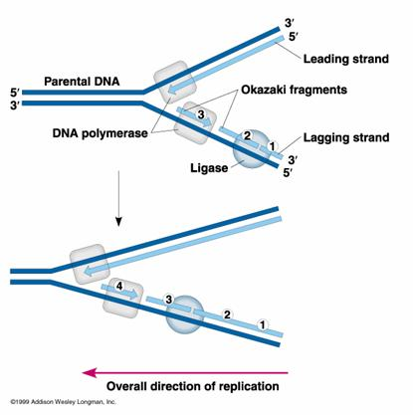
6. The lagging strand is the DNA template in which discontinuous replication occurs resulting in the synthesis of Okazaki fragments which must be connected by DNA ligases.
Ligase can catalyze the formation of a phosphodiester bond given an unattached but adjacent 3'OH and 5'phosphate.

Slide 26
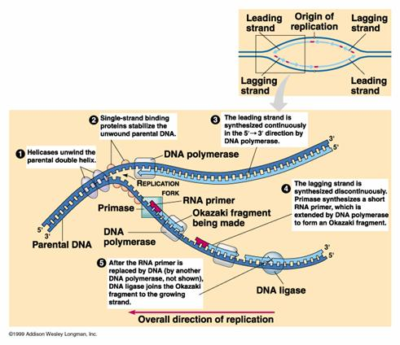
DNA Replication

Slide 27
c) Proofreading:
1. Due to the inordinately high numbers of nucleotides that must be added to the parent strand to synthesis new daughter DNA molecules, errors are quite common.
Original replication results in about three mistakes in 105 nucleotides.
At this rate 3% of proteins would be changed in a single replication, too many errors for survival of a species.
2. Catastrophic mutations would occur if the mistakes were not corrected.
3. DNA polymerase can act as an endo- or exonuclease in that it proofreads the newly synthesized DNA strand, locates errors, and excises erroneously paired nucleotides to avoid mutations.
http://academy.d20.co.edu/kadets/lundberg/DNA_animations/dna.dcr

Slide 28
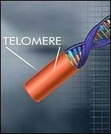
d) Telomeres and the Replication of the terminal ends of DNA
1. Telomeres are the physical ends of linear eukaryotic chromosomes.
2. They are specialized nucleoprotein complexes that have important functions, primarily in the protection, replication, and stabilization of the chromosome ends.
3. In most organisms studied, telomeres contain lengthy stretches of tandemly repeated simple DNA sequences composed of a G- rich strand and a C-rich strand (called terminal repeats).
4. These terminal repeats are highly conserved; in fact all vertebrates appear to have the same simple sequence repeat in telomeres: (TTAGGG)n.

Slide 29
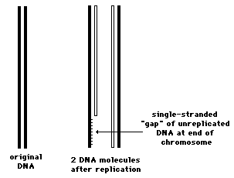
5. Replication of linear chromosomes presents a special problem
DNA polymerase can only add nucleotides to the 3’ end of a preexisting polynucleotide.
The molecular requirements of the process are such that 5' end of each newly-synthesized strand cannot be completed.
DNA polymerase needs a primer – but lagging strand primer cannot be beyond end of molecule.
This would mean chromosome would get shorter with every replication – 1 primer at a time.

Slide 30
Thus each of the daughter chromosomes will have a shortened telomere.
The solution is an enzyme called telomerase that adds short DNA repeats to end of chromosome.
It is estimated that human telomeres lose about 100 base pairs from their telomeric DNA at each mitosis.
This represents about 16 TTAGGG repeats. At this rate, after 125 mitotic divisions, the telomeres would be completely gone.
When the telomere becomes too short, the chromosome reaches a "critical length" and can no longer replicate. This means that a cell becomes "old" and dies by a process called apoptosis.
Is this why normal somatic cells are limited in the number of mitotic divisions before they die out?

Slide 31
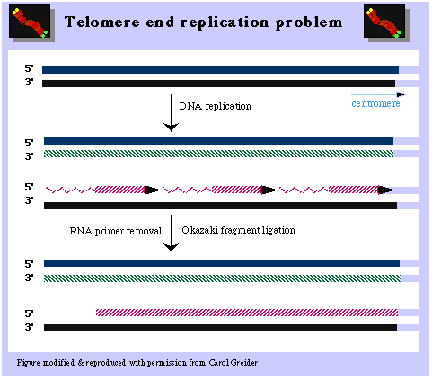
End replication problem
This figure demonstrates that, without a mechanism to elongate the lagging strand, chromosomes will naturally shorten with each successive round of DNA replication.

Slide 32
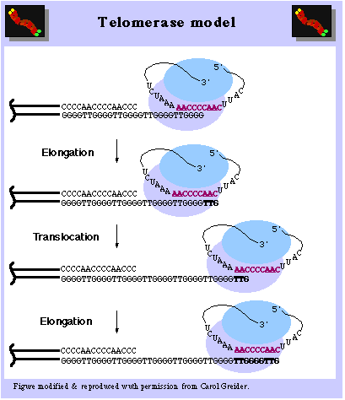
Telomerase, a reverse transcriptase, extends the lagging DNA strand.

Slide 33
Telomerase
Telomerase is an enzyme that adds telomere repeat sequences to the 5' end of DNA strands. By lengthening the strand prior to replication, cells with active telomerase are able to compensate for telomere shortening during DNA replication.

